Slide 1
Types of Energy

Slide 2
Energy moves through systems, both natural and man-made.
Your body is a remarkable system that takes energy from food and keeps you running.
Your parents' car is a system too! as is your computer and your cell phone.
There are countless amazing systems in our world, but in this module we can only look at a few of them.

Slide 3
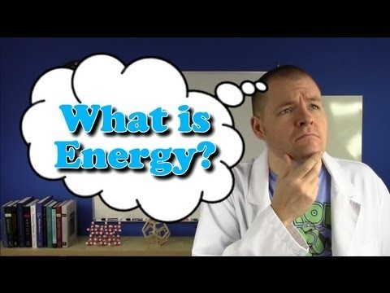

Slide 4


Work doesn't just mean washing your dishes - it is much more fundamental than that! As you will see, many physical and chemical processes require work in some form.
Burning wood requires work, as does lifting a cardboard box. As we go through this module, you will become much more familiar with the idea of work.

Slide 5
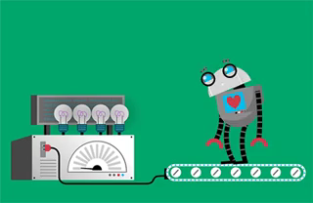
There are two major types of energy: kinetic energy and potential energy.
Kinetic energy is energy due to movement. It describes not only the motion of objects, but also explains heat, light and sound.

Slide 6
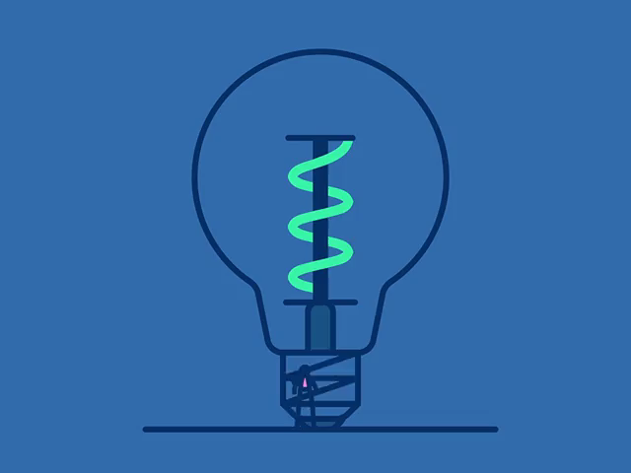
Potential energy is energy that is stored in objects or particles.
It manifests itself in many different forms, such as gravitational, chemical and nuclear potential energy.

Slide 7
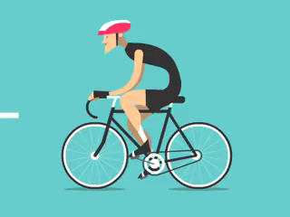
Kinetic energy is the energy a moving object has due to its movement. This means that all moving objects, from cyclists to falcons, have it.
The amount of kinetic energy depends on the object's mass and speed. If it has a lot of mass, or is moving very fast, it has lots of kinetic energy.

Slide 8

Any moving thing can have kinetic energy.
Even the atoms that make up everything around us move.
In gases, the atoms whizz around like hyperactive kids, showing that they have lots of kinetic energy.

Slide 9

Even in solids, which are rigid, atoms have kinetic energy because they vibrate.
The speed of this vibration is what we feel as heat - so heat is really just kinetic energy!

Slide 10
Potential energy is energy that is stored in objects. There are five different types of potential energy that you need to learn about.
These are:
• | Gravitational
• | Chemical
• | Elastic
• | Electrical
• | Nuclear

Slide 11

Gravitational potential energy (GPE) is stored in objects that are held above the ground. For instance, a plane in flight has gravitational potential energy because it's above the ground.
The amount of GPE an object has depends on the strength of gravity. It also depends on the object's mass and height.
The more mass it has and the higher it is, the more GPE it possesses.

Slide 12
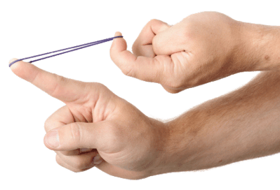
Elastic potential energy is stored in stretched or compressed materials, such as rubber bands or springs. These are collectively called elastic materials.
If you deform (change the shape of) an elastic material, it stores elastic potential energy. When you let it go, that energy helps the material return to its original shape. The more you deform it, the more energy builds up.

Slide 13
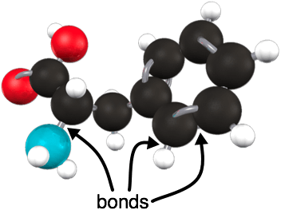

Chemical potential energy is stored in the bonds between atoms in a substance. Every solid, liquid and gas has some chemical potential energy, which gives it the ability to participate in chemical reactions.
Humans and other animals need this type of energy to survive. You take in chemical potential energy from food and use it to power your body!

Slide 14
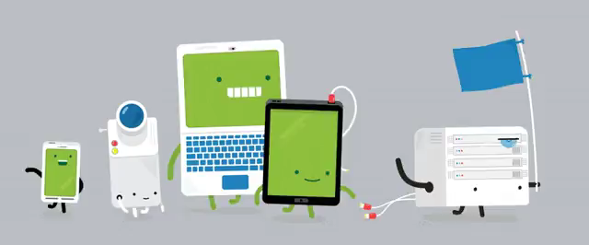
Electrical potential energy is stored in charged objects or particles.
The battery in your cell phone has lots of electrical potential energy. When you switch your phone on, that energy is converted into electricity, which powers your camera and all your apps!

Slide 15
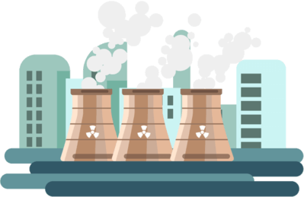
Finally, we have nuclear potential energy. This type of energy is hard to understand, so don't worry about it too much at this level.
Nuclear potential energy is found inside the nuclei of atoms - their dense cores made of protons and neutrons.
This energy helps to hold the nucleus together. However, the nucleus sometimes breaks apart, releasing some energy in the process of radioactivity.

Slide 16


